Slide 1
Blown Film(2)

Slide 2
Outline
Background of Flat Film Forming
Dies
T-slot
Coat hanger
Coextrusion
Rolling/Cooling of Film
Wind up
Process dependent properties
Model
Uses
Applications
Cast Film Technology. Promea engineering. (2004). http://www.promea.com/_modules/rightcol_pce/pce1_037.jpg

Slide 3
Introduction
Film extrusion is one of the most important processes for plastics accounting for almost a quarter of all thermoplastics consumed
Has enjoyed some periods of rapid growth in recent years, particularly within the packaging industry
Film is defined as a sheet less than 250 μm in thickness
There are two types of film extrusion: cast film and blown film

Slide 4
Introduction
Cast film extrusion is a continuous operation of melting and conveying a polymer in a heated screw-and-barrel assembly
Polymer is extruded through a slit onto a chilled, highly polished turning roll, where it is quenched from one side
Film is sent to a second roller for cooling on the other side
Alternatively, polymer web is passed through a quench tank for cooling
Film then passes through a system of rollers, which have different purposes, and is finally wound onto a roll for storage

Slide 5
Dies
Most flat dies are of T-slot or coat hanger designs, which contain a manifold to spread the flowing polymer across the width of the die, followed downstream by alternating narrow and open slits to create the desired flow distribution and pressure drop

Slide 6
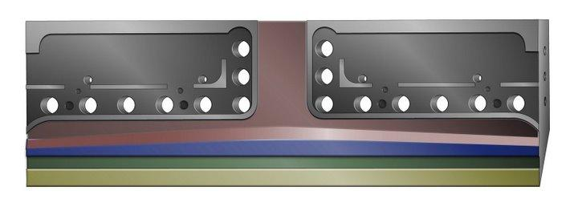
T-slot Die
The basic manifold for a sheet die is a constant cross section or T-slot design
Relies on a large manifold area and a lip long enough to create a large enough pressure drop to force the melt to the ends of the die
Used when processing low viscosity plastics that are not thermally sensitive
http://picasaweb.google.com/Martinocomms/ExtrusionDiesIndustriesEDIDieSystemsForBarrierPackaging#5141303001253924450

Slide 7
Coat Hanger Die
Conventional constant-deflection die
Internal pressures cause the polymer to deflect uniformly across the width of the die
Delivers more streamlined flow since there are few areas where melt flow rates may slow and material linger long enough for polymer degradation to occur
http://picasaweb.google.com/Martinocomms/ExtrusionDiesIndustriesEDIDieSystemsForBarrierPackaging#5141303001253924450

Slide 8
Coextrusion
Most cast film lines today are coextrusion lines, combining layers from as many as 7 extruders into the product through multi-manifold dies, or else single manifold dies with the aid of feedblocks
When the materials enter the die, they are no longer confined individually within steel channels. They are in intimate contact with each other and in the fluid state
Layers in the final film will be uniform if the adjoining materials have a reasonable rheological match and there is uniform flow distribution inside the die
When layer distortion occurs it happens in the die, not the feedblock, during the transition or distribution in shape from the square incoming stream to the wide, thin film shape

Slide 9
Film extrudate after die
Equipment
Cooling – chill rolling or quench tank
Take-Off
Windup
Equipment purpose:
Cool
Draw
Shape
Windup
Handle
Notes:
Extrudiate after the die are in various shapes and various conditions of temperature and stiffness

Slide 10
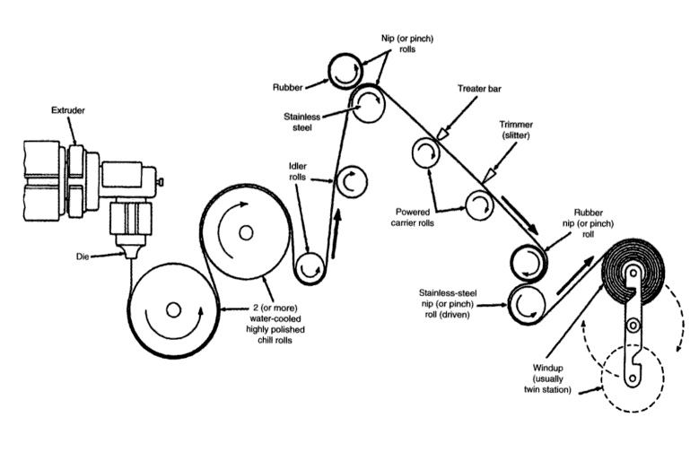
Chill-roll assembly
Rosato, Dominick. Plastics Engineering, Manufacturing & Data Handbook. “Ch.3: Extrusion”. Plastic Institute of America. Springer. (2001). Online access from Knovel.

Slide 11
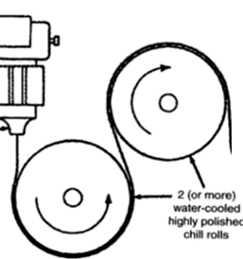
Chill rolled cooling
The film extrudate leaves the die typically in a downward motion
Extrudate is pulled away from die and onto a water cooled roller (chill roller)
Air knife is sometimes used to ensure intimate contact between polymer and roll
Die and chill rolls are positioned as close as possible
e.g. gap for HDPE is approx. 13mm
Heat transfer to rolls : conduction
Thermal conductivity of both polymer
and roller material
Chill rollers speed control final
thickness, drawdown and neck-in effects
Rosato, Dominick. Plastics Engineering, Manufacturing & Data Handbook. “Ch.3: Extrusion”. Plastic Institute of America. Springer. (2001). Online access from Knovel.

Slide 12
Contacting the chill roll
Optimally, the molten polymer drops onto the chill roll and contacts tangentially
The alignment or parallelism of this roll to the die is critical in relation to the falling film
Whenever wrinkling of the film occurs on the casting roll surface, it is likely that the first roll must be repositioned

Slide 13
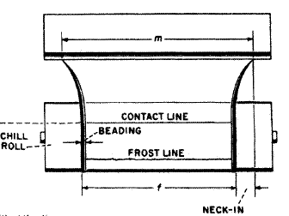
“Neck-in” effects
Hot film extrudate is drawn to the colder rollers
Shrinking at edges : Neck in leads to beading
Shrinkage at edge depends upon polymer melt temperature and polymer itself
Rosato, Dominick. Plastics Engineering, Manufacturing & Data Handbook. “Ch.3: Extrusion”. Plastic Institute of America. Springer. (2001). Online access from Knovel.

Slide 14
Chill rollers
High gloss finish – chromium finish for highly polished roll
Matte finish – metal rolls are sandblasted, acid etched, or machined
Design Criteria: polymer cannot stick to rollers
Thermal conductivity and conduction of heat from molten polymer to chilled rollers
At least two or more rolls

Slide 15
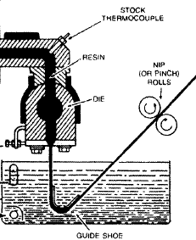
Quench tank cooling
Difficult to control precise variables such as water temperature
Good optical properties and low operating cost compared to chill rolled cooling
Film defects are common
Vibration and water movement
Less common today than chill
rolled cooling
Rosato, Dominick. Plastics Engineering, Manufacturing & Data Handbook. “Ch.3: Extrusion”. Plastic Institute of America. Springer. (2001). Online access from Knovel.

Slide 16
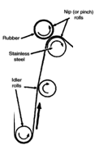
Take-Off Rollers
Linear rate extrudate is removed from die
Controls the velocity of the roller system
Thickness control
Require accurate and sensitive speed controls
Multifunction to cool the polymer film
Rosato, Dominick. Plastics Engineering, Manufacturing & Data Handbook. “Ch.3: Extrusion”. Plastic Institute of America. Springer. (2001). Online access from Knovel.

Slide 17
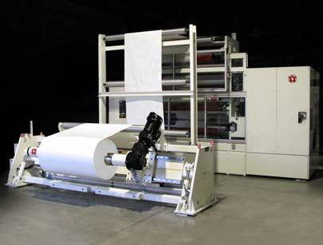
Intermediate and Windup Steps
Winder for plastic film extrusion. Direct Industry. (2009) http://www.directindustry.com/prod/battenfeld-gloucester/winder-for-plastic-film-extrusion-20385-45141.html
Slitter –
cuts film edge to wanted width
Removes the “beaded” film
Scraps are typically recycled or reused
Gauging –
Film thickness gauges
Allows for user feedback to change or alter processing conditions
Surface treatment
Plasma/Corona Treatment
Change surface energy
Winders
Apply constant tension to film
Speeds of 2000ft/min
Diameters up to 5ft
Width up to 20ft
Winder for plastic film extrusion. Direct Industry. (2009) http://www.directindustry.com/prod/battenfeld-gloucester/winder-for-plastic-film-extrusion-20385-45141.html

Slide 18
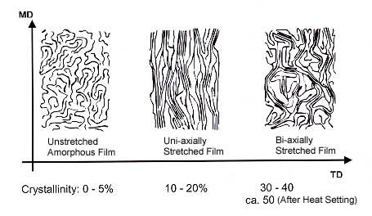
Film Orientation
Uniaxial
High orientation in machine direction (MD)
Polymer is being “drawn” by the cooling and take off rollers
Polymer chain alignment
Low orientation in transverse direction (TD)
Critical draw ratio
Parameter to control orientation
Biaxial orientation is possible by stretching polymer in both directions
Critical for mechanical
properties
Mitsubishi Polyester Film. Biaxial Orienation. (2009) http://www.m-petfilm.com/Europe/images/biaxial.jpg&imgrefurl

Slide 19
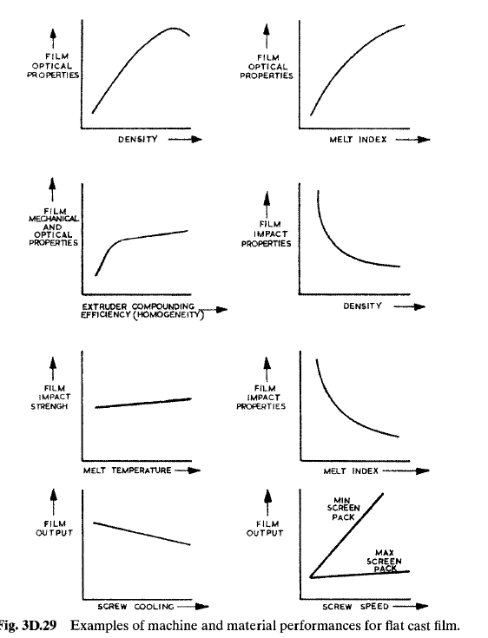
Process depend properties
Polymer Density
Melt Index
Melt Temperature
Screw cooling
Screw speed
Extruder compound efficiency
Rosato, Dominick. Plastics Engineering, Manufacturing & Data Handbook. “Ch.3: Extrusion”. Plastic Institute of America. Springer. (2001). Online access from Knovel.

Slide 20
Optical Properties
Melt temperature (T_{m})
Lower Relative T_{m}: Hazy, lower elongation at break and tensile strength
Higher Relative T_{m}: Glossy finish, higher elongation at break and tensile strength
Cooling Rollers:
Optimal optical properties: 10°^{C} less than temperature need to melt polymer onto the rollers
Must control within 2°C range

Slide 21
Common Polymers
Polyolefins are the most widely-used plastics for film extrusion
Polyolefins that can be extruded as monolayer and multi-layer film:
low density polyethylene (LDPE)
linear low density polyethylene (LLDPE)
high density polyethylene (HDPE)
ethylene copolymers
ethylene vinyl acetate (EVA), ethylene methyl acrylate (EMA)
polypropylene and propylene copolymers
thermoplastic olefins (TPOs)

Slide 22
Benefits
Advantages of polyolefin films:
Ease of processing
Light weight
Good toughness and tear resistance
Flexibility (even at low temperatures)
Outstanding chemical resistance
Relatively low cost compared with other plastics

Slide 23
Properties
The basic properties of polyolefins can be changed using a broad range of chemical modifiers
In addition, polyolefin-based films can be coextruded with various other polymers, including ethylene vinyl alcohol (EVOH), nylon, polyester barrier resins and adhesive tielayers, to produce multilayer films with special, high-performance properties

Slide 24
Stability Analysis of Film Casting
Stability analysis of cast film
Conditions: Isothermal, viscoelastic
Extrudate Film Relaxation time relationship
Attained by:
Relating White-Metzner time constant to viscosity
Bird—Carreau viscosity model
Deborah number – De
Relates relaxation time of polymer and characteristic process time
Known parameter
L = length between slit die and first chill roll

Slide 25
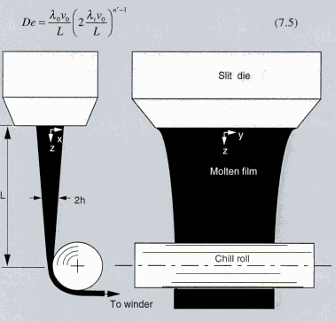
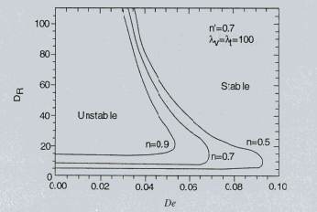
Stability Analysis Results
Stable and unstable regions (constant n)
Model relates the Deborah number and the draw ratio of the film
Draw ratio = quantitative method to evaluate how much the polymer has stretched (drawn by rollers)
Stability analysis allows for feedback on stable/unstable viscosities of the film extrudate with respect to De and D_{R}
Allows for change in process conditions (i.e. change L or melt viscosity)
Stable and unstable regions (constant n′)
Taken from Polymer Processing Fundamentals by Tim A. Osswald

Slide 26
Advantages Over Blown Film
More significant cooling
Can run high T melt, lower viscosity and less blocking
Thickness Control
No bubble, fed directly to roller
Optical Properties
Lower Density

Slide 27
Disadvantages
Strength in MD and TD
Maximum toughness
Less processing time for bag applications
Lower maximum width
Edge trimming
Wasted material

Slide 28
Photo Thermoplastic Film
Coextruded
Transparent plastic, photoconductive, insulating thermoplastic
Applications
Particle Image Velocimetry
Polarizers / Support Films in Polarizers
LCD Panels
Touchscreen
Mobile Phone
http://www.zeonex.com/applications_zeonorfilm.asp

Slide 29
Applications
Packaging
Photovoltaics: Back sheets and top sheets
Transportation: Train, bus, and aircraft interiors; car and truck body panels
Construction: thermoformed panels for facades, window profiles or transparent roofing panels; vinyl siding; high-pressure laminates; vinyl wall coverings
Technical Textiles: PVC tarpaulins, tents and canopies; liners for flexible tanks; protection of sails, balloons and blimps; fire-retardant textiles
http://www.arkema-inc.com/kynar/page.cfm?pag=1168

Slide 30
پایان

